Slide 1
CIS 5560 Machine learning
Microsoft Azure Machine learning Studio
&
DATABRICKS

Slide 2
Presented by:- (Group- 1)
SUSHANT BURDE (CIN: 307396822)
SWARNIM JAMBHULE (CIN: 307375385)
TANVI GAWADE (CIN: 306668484)

Slide 3

About the dataset
This is a dataset hosted by the City of Seattle
Integrated Library System (ILS) Data Dictionary: This dataset is useful for understanding the codes used in other corresponding Seattle Public Library datasets. These codes (namely "ItemType" and "ItemCollection") are systematically used in the cataloging of items within Integrated Library System (ILS). The data is used in the daily operation of the library, including circulation, cataloging, acquisitions, collection development, processing, and serials control.
Library Collection Inventory :Consists of all of the physical items in the Seattle Public Library’s collection.
Checkouts by Title :This dataset includes a monthly count of Seattle Public Library checkouts by title for physical and electronic items. The dataset begins with checkouts that occurred in April 2005 and is updated till date.

Slide 4
WHY THIS dataset
Seattle Public Library’s Open Data workshop, Open Data: Couch to 5k, aims to support people’s interest in accessing, understanding, using, and analyzing open data while cultivating new ideas and advocating for open data as a tool for public engagement.
Municipalities are increasingly attempting to utilize data to drive evidence-based policy decisions around things like resource allocation and improvement of library management and services.

Slide 5
DATA SET Specifications :
Seattle Public Library Dataset.
Contents of the dataset: Checkouts by Title, Library Collection Inventory, Integrated Library System (ILS) Data Dictionary
Link(https://data.seattle.gov/Community/Library-Collection-Inventory/6vkj-f5xf)
Link (https://data.seattle.gov/Community/Checkouts-by-Title/tmmm-ytt6)

Slide 6
DATA SET Specifications :
Link(https://data.seattle.gov/Community/Integrated-Library-System-ILS-Data-Dictionary/pbt3-ytbc)
Total Size of the data: 7.8 GB

Slide 7
Homework Experimental specifications
Data Bricks Specifications:
Execution: Single Node
Memory: 6GB Capacity
Databricks Runtime Version: 5.2(Incl. Apache Spark 2.4.0, Scala 2.11)
Microsoft Azure Machine Learning Studio Specification:
Execution: Single Node
Storage Space Capacity: 10 GB Memory
Compute Resource Type: ML service is a multitenant service.

Slide 8
MICROSOFT AZURE MACHINE LEARNING STUDIO
MODEL 1: 2 Class Decision Jungle
We have created a model to classify whether the book is floating or not floating(i.e. Circulatory within the Seattle branches or not)
We have used the dataset Library Inventory Dataset for the above classification.
Classification is based on the column Floating Item where Floating Item = Yes and Non Floating Item = No
Data is split into train and test in the ratio of 0.8 0.2
Algorithm used for the above evaluation : 2 Class Decision Jungle

Slide 9
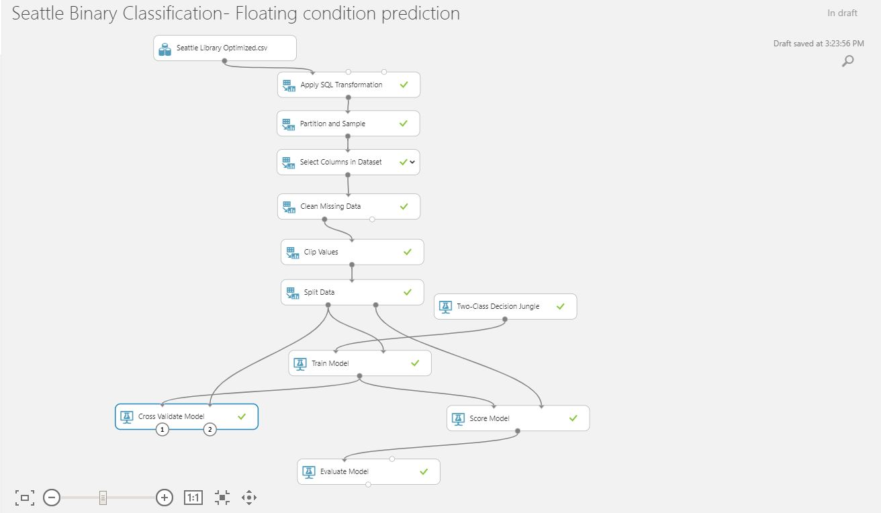
Model 1:

Slide 10

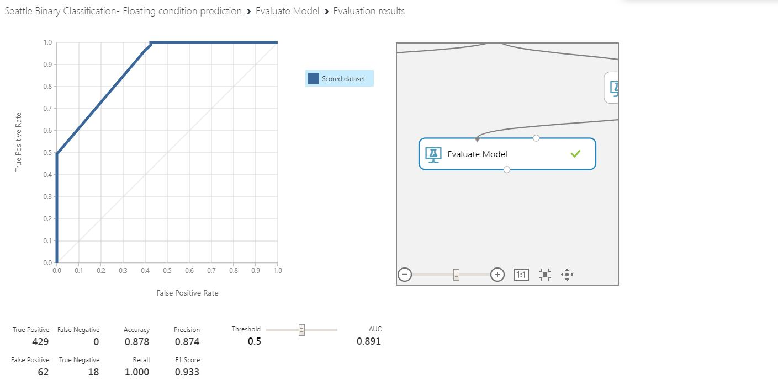
ALGORITHM USED:
2 CLASS DECISION JUNGLE
SPLIT DATA is 80-20 and it is Randomized Split
AUC : 0.891

Slide 11
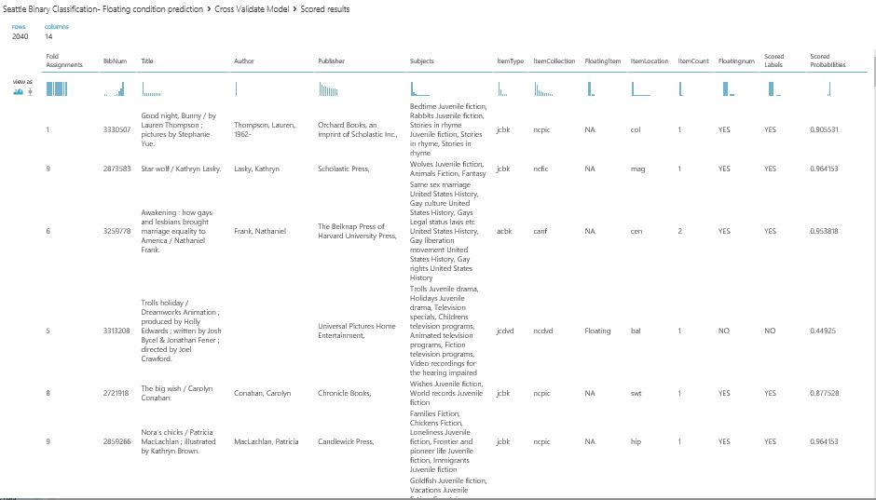
CROSS VALIDATION OUTPUT:

Slide 12
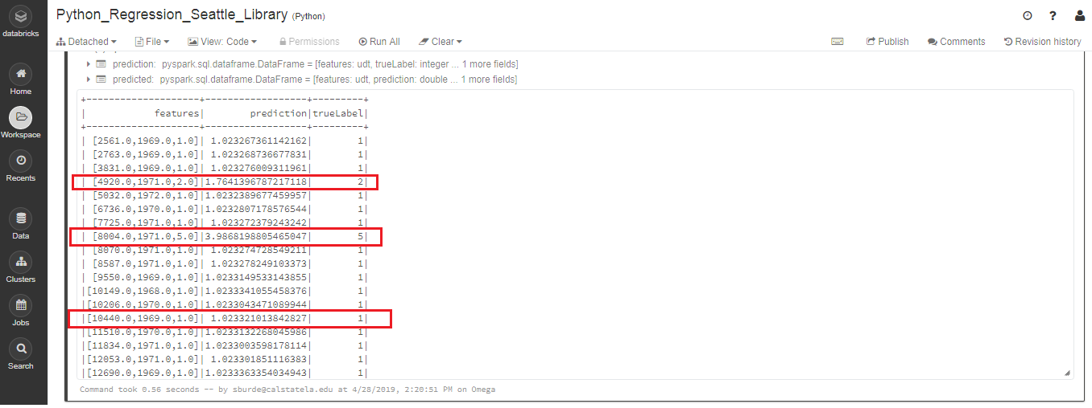
DATA Bricks (SPARK Machine Learning)
MODEL 1:
ALGORITHM USED : LINEAR REGRESSION
OUTPUT: Predicted column contains the predicted value for the label, TrueLabel column contains the actual known value from the testing data.

Slide 13
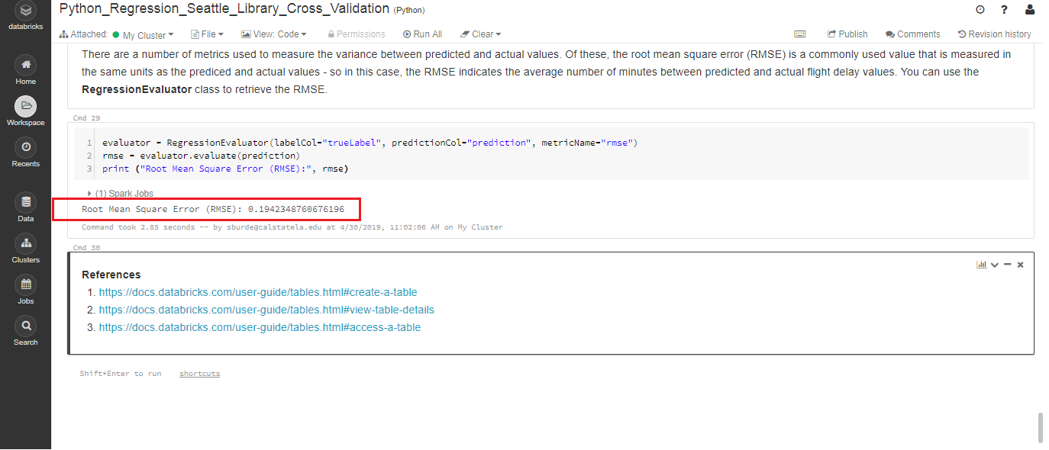
MODEL 1:
RMSE : 0.19423

Slide 14
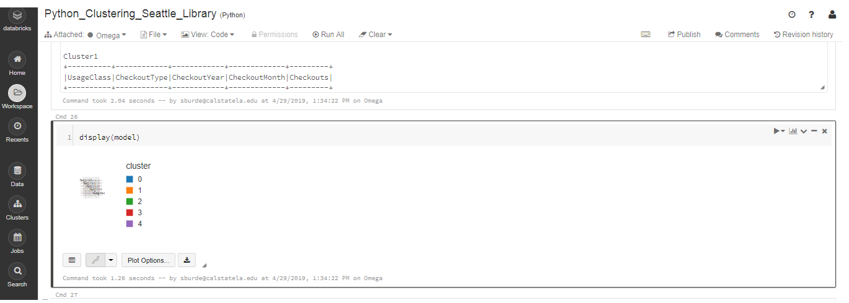
DATA Bricks (SPARK Machine Learning)
MODEL 2:
ALGORITHM USED : CLUSTERING
OUTPUT: Clustering is based on Major distributer sources like Horizon, Overdrive, Freegal, Hoopla and Zinio.

Slide 15
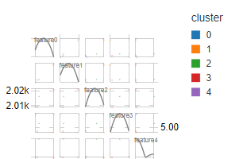
DATA Bricks (SPARK Machine Learning)
MODEL 2:
ALGORITHM USED : CLUSTERING
OUTPUT: Enlarged Version of Clustered Model

Slide 16
References:
https://docs.microsoft.com/en-us/azure/machine-learning/studio/create-experiment
https://forums.databricks.com/
https://stackoverflow.com/questions/tagged/databricks
https://docs.microsoft.com/en-us/azure/machine-learning/studio/faq

Slide 17
Microsoft Azure Machine Learning
https://gallery.azure.ai/Experiment/Seattle-Binary-Classification-Floating-condition-prediction

Slide 18
Thank you!!!

